Slide 1
Secure Date hiding images using steganography
CAPSTONE PROJECT
Presented By: Aditya Singh Tomar
Student Name : Aditya Singh Tomar
College Name & Department : Bhagwan Parshuram Institute of Technology

Slide 2
OUTLINE
Problem Statement
Technology used
Wow factor
End users
Result
Conclusion
Git-hub Link
Future scope

Slide 3
Problem Statement
With the increasing need for secure communication, concealing secret messages within images provides an innovative way to protect sensitive data. This project implements steganography using OpenCV to hide and retrieve messages inside an image.

Slide 4
Technology used
– Programming Language: Python – Libraries: OpenCV, TensorFlow, Scikit-learn – Platforms: Python IDLE – Additional Tools: Git for version control

Slide 5
Wow factors
Encrypts text inside an image pixel-by-pixel
Password-protected encryption for extra security
Lightweight & fast implementation using OpenCV & NumPy
Can be extended to audio & video steganography

Slide 6
End users
Journalists & Whistleblowers – Secure communication in high-risk environments
Government & Military – Confidential message transmission
Cybersecurity Professionals – Secure data exchange
General Users – Privacy in personal communication

Slide 7
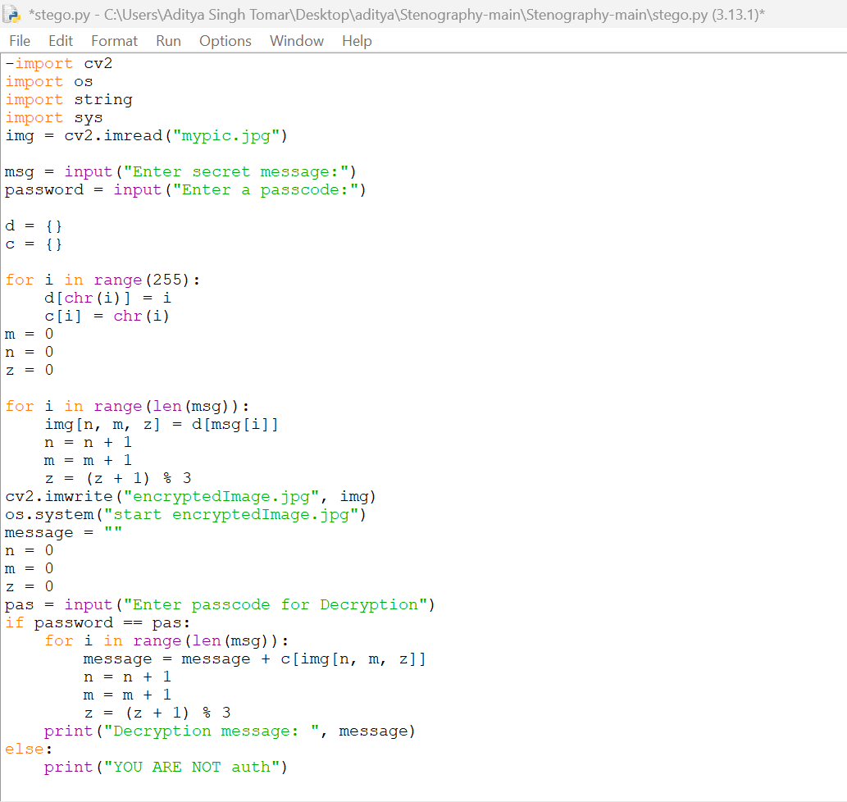
Results

Slide 8
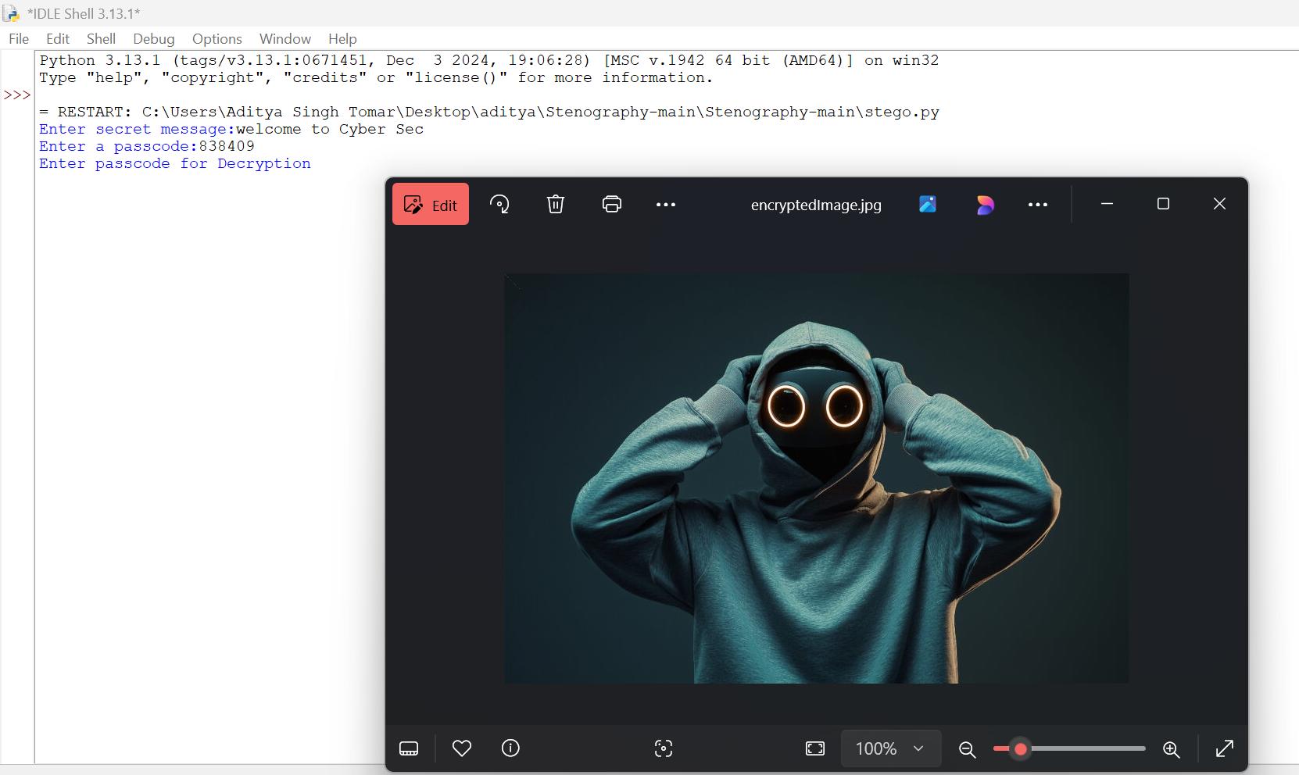

Slide 9
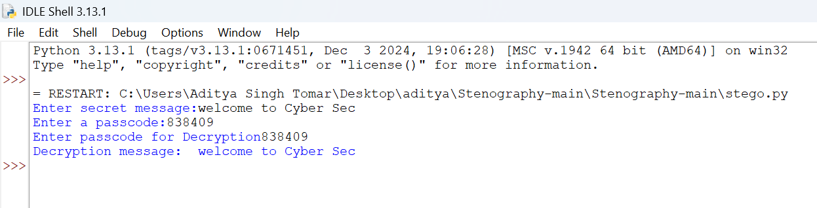
Results

Slide 10
Conclusion
This project successfully implements a simple yet effective method for hiding and retrieving secret messages in images. By leveraging image processing, it enhances secure communication and can be expanded further for real-world applications.

Slide 11
GitHub Link
https://github.com/Aditya1906-code/Cyber-Security-steganography.git

Slide 12
Future scope
Support for video & audio steganography
AI-based detection of steganographic attacks
Blockchain integration for secure data verification
Mobile app implementation for encrypted communication

Slide 13


